Slide 1
FY 2023 April–september media plan
Tourist Development Council – 4/19/23

Slide 2
Marketing strategy

Slide 3
Marketing Objectives
Drive visitation
Build awareness and intent
Increase visitor spend
Position St. Pete/Clearwater as a premier destination with a diverse collection of world-class arts and culture
Highlight inclusive and diverse culture of the destination (accessibility)
Notes:
Drive visitation
Positively impact tourist development tax by driving increased overnight visitation
Continue to explore opportunities to efficiently increase awareness and travel from OOS markets
Increase intent to travel across all advertised geographies and audiences
Position St. Pete/Clearwater as a premier destination with a diverse collection of world-class arts and culture
Highlight inclusive and diverse culture of the destination (accessibility)
Re-enter international markets
Be prepared/business continuity
Position Visit St. Pete/Clearwater as the official destination management organization that not only promotes tourism but helps manage its impacts on residents and partners
Promote sustainability

Slide 4
Marketing Strategies
Prioritize markets offering the greatest opportunity to generate visitation
Use a media mix that will reach consumers across multiple touch points
Identify opportunities to elevate the brand through partnerships, activations and unique media opportunities
Market St. Pete/Clearwater as a four-season destination with an annual media presence with focus on need periods
Continue to showcase new brand campaign
Notes:
Carmen

Slide 5
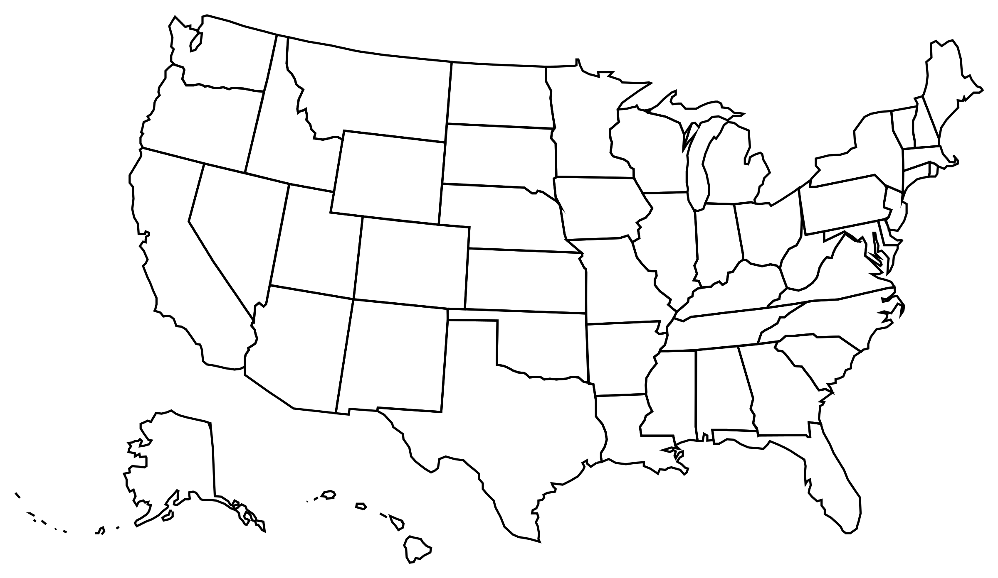
Geographic Market Strategy
Focus on markets with most opportunity through integrated campaigns
Reach broader, secondary markets with digital, social and public relations
Developmental (5) Out-of-state markets
Great growth opportunity
Less awareness and familiarization with destination
Low repeat visitation
Maintenance
(5) In-state + key out-of-state markets
50%+ of arrivals
Higher awareness and familiarization
High repeat visitation in-state

Slide 6
Geographic Markets
Developmental (Tier 1)
Chicago
Atlanta
Indianapolis
Minneapolis
Detroit
Maintenance
Orlando
Jacksonville
Tampa-St. Pete
Nashville
Cincinnati
New market for FY23
Broadcast (Cable/Radio)
Out of Home
Print
Promotions/Activations
Broadcast (Radio)
Out of Home
Promotions/Activations

Slide 7
Leisure Core Audience
Adults 25-65
$100K+ household income
Likely to travel to Florida on Vacation
Interest in Beach and Arts/Culture
Index high on “Vibrancy" indicators
Fun: Life should be as much fun as possible
Variety: Seek out variety in everyday life
Curious: Explore and learn about new things
Excitement: Have stimulating experiences

Slide 8
Arts Audience
Arts enthusiasts are more likely than general audience to:
Learn about destinations
Travel
Heavy travel/lifestyle magazine readers, Instagram and Twitter users
Aligns with our persona:
Looks for great culinary options
Wants to be near nature
Desires a memorable, fun destination
Wants to visit a unique destination with lots of energy
*Source: Destination Analysts

Slide 9
Media Consumption Habits of Target Audience
Magazine
19% more likely than national average to read magazine
Radio
13% more likely than national average to listen to radio
Television
Average consumption which is common with affluent audience
Out of Home
25% more likely than national average to be influenced by OOH
Social Media
12% more likely than national average to use social media
Internet
10% more likely than national average to use the internet
Source: Fall 2021 Doublebase GfK MRI

Slide 10
april - september Media plan
Notes:
Flight media placements on most impactful timeframes
3-6 months out “sweet spot” for first exposure
60 days between decision to visit and arrival
Brief pauses/pull back to extend budget and maximize impact while in market
Increase support for need periods
Maintenance level for peak periods
Pursue unique media opportunities
Explore brand alignments/partnerships
Target our audiences based on persona

Slide 11
Broadcast Media

Slide 12
Broadcast Media (Television) Developmental Markets
Hyper-targeted approach to traditional television/cable
Focus on high indexing HH’s and programming
Partnership with Innovid to help with tracking exposure
30-second spot
Markets: Chicago, Atlanta, Indianapolis, Minneapolis, Detroit
July ‘23-Sept ‘23 (6-weeks flighted)
81.7M impressions (estimated)

Slide 13
Broadcast Media (Radio) Developmental + Maintenance Markets
Focus on high indexing station formats
NPR – Arts/Culture
Spanish/Latinx – Latin Audience
Urban Contemporary – Black Audience
Extend the spot buys with value added promotional partnership and influencer campaigns
30-second spot
Markets: Chicago, Atlanta, Indianapolis, Minneapolis, Detroit, Nashville, Cincinnati, Orlando, Jacksonville, Tampa-St Pete
Retail strategy – Incorporate a call to action and/or last-minute deals to encourage immediate action (bookings)
July ‘23-Sept ‘23 (5-weeks flighted with Cable)
119.2M impressions (estimated)

Slide 14
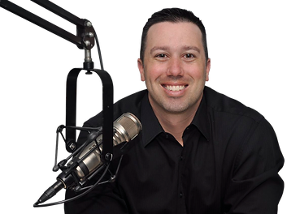
Broadcast Media (Radio) Developmental + Maintenance Markets
Tourism Talk Tampa Bay
Local Tampa Bay Market
Continuation of the VSPC Tourism Talk segments on the “The Ryan Gorman Show”
Ryan will interview Steve each month – 5-minute segment focusing primarily on “business of tourism”
(10) segments running March-December 2023
Multi-media promotion
Full 5-minute interview to air each month during the regularly schedule time
Each episode will be pre-promoted for five days prior with :15 mentions, show’s blog and social sites
Five days after episode airs, :15 “in case you missed” spots will run promoting listening to the full episode digitally.
Episodes will be available for stakeholders and industry websites
Episodes will live on AM Tampa Bay’s site
Estimate 1.5M impressions

Slide 15
Out of home Media

Slide 16
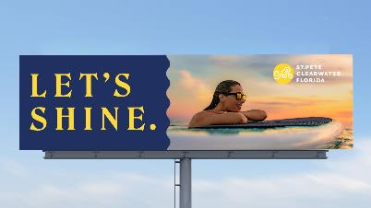
Digital Billboard Network Developmental + Maintenance Markets
Markets: Chicago, Atlanta, Indianapolis, Minneapolis, Detroit, Nashville, Cincinnati, Orlando, Jacksonville, Tampa-St Pete
Hyper-targeted approach to traditional billboards
Focus on the person vs. location
Creative will be versioned based on target audience, similar to how we would approach digital placements
June-September ‘23 (4) 4-week periods
230.3M impressions (estimated)

Slide 17
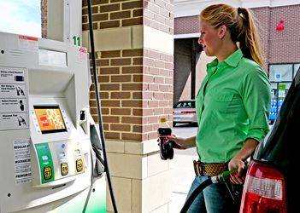
Gas Station TV Developmental + Maintenance Markets
Markets: Chicago, Atlanta, Indianapolis, Minneapolis, Detroit, Orlando, Jacksonville, Nashville and Cincinnati
Expanded into Maintenance Markets for summer
30-second spot w/ audio
Targeted to align with cable HH’s
Captive audience
Multi-media approach aligning with television, radio and digital billboards
June-September ‘23 (4) 4-week periods
698 stations – 6,687 screens
26.8M impressions (estimated)

Slide 18
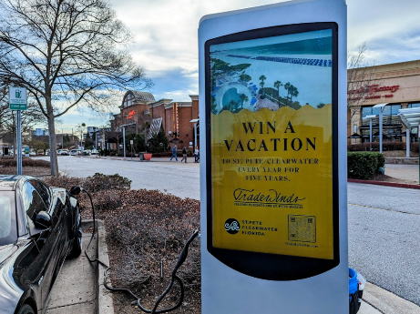
Digital EV Charging Stations Developmental Markets
Markets: Chicago, Atlanta, Indianapolis, Detroit
Digital EV Charging Stations (:08 spot)
Targeted to align with cable HH’s
Captive audience
Average charging time is 30 minutes
Multi-media approach aligning with television, radio, digital billboards and Gas Station TV
179 Index: EV Ownership
June-September ‘23 (4) 4-week periods
145 screens
7.7M impressions (estimated)
Source: Fall 2021 Doublebase GfK MRI

Slide 19
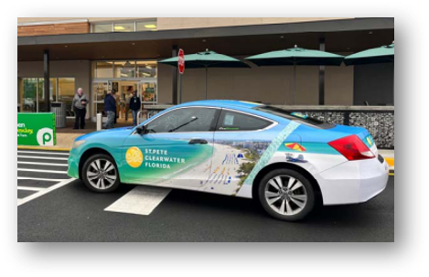
Rideshare Vehicle Wraps
Market: Atlanta, potentially others
August-September ‘23 (2) 4-week periods
VSPC branded vehicles
Full vehicle wrap
Back window decals (bonus)
Pamphlet-one sheet card driver handouts (bonus)
Sweepstakes (bonus)
Vehicle swarm
5.2M+ impressions (estimated)

Slide 20
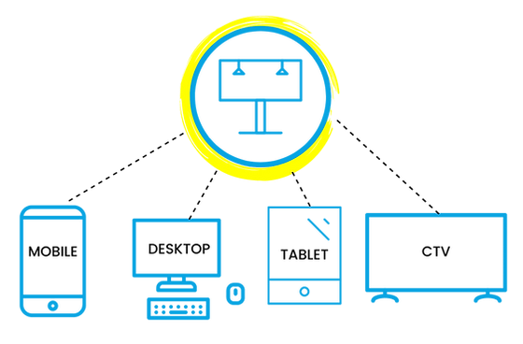
FY23 Media Plan Out-of-Home Exposed Cross-Device Retargeting
Elevating our OOH efforts with a trackable call to action!
Consumers exposed to a digital OOH ad will be retargeted with a web banner ad
Digital BBs (50-100 yards)
Gas Station TV (10-ft radius)
EV Charging Stations (50-ft radius)
Carvertise (50-ft radius)
Markets: Chicago, Atlanta, Indianapolis, Detroit, Minneapolis, Orlando, Jacksonville, Nashville and Cincinnati
June-September‘23 (4) 4-week periods
50.0M+ impressions (estimated)

Slide 21
Print Media

Slide 22
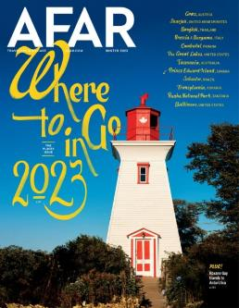
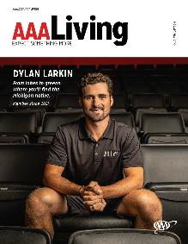
Print Media Consumer Travel: National/Regional
Source: Fall 2021 Doublebase GfK MRI

Slide 23
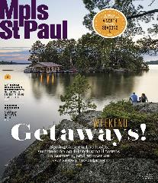
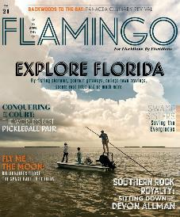
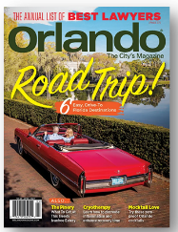
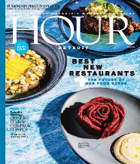
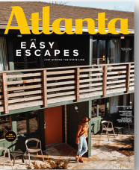
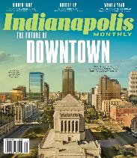
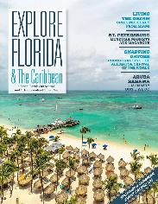
Print Media Consumer Travel: City Magazines
City/Lifestyle publications offer a favorable index against our persona (123 index)
Source: Fall 2021 Doublebase GfK MRI

Slide 24
Print Media Arts & Culture
Arts Enthusiasts are 17% more likely to read printed magazines
Source: Fall 2021 Doublebase GfK MRI

Slide 25
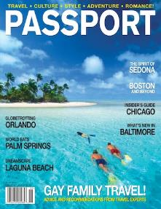
Print Media LGBTQ+ Audience
LGBTQ+ travel enthusiast is 32% more likely to read printed magazine
Source: Fall 2021 Doublebase GfK MRI

Slide 26
Print Media Black Audience
African-American consumer is 28% more likely to read printed magazine
Source: Fall 2021 Doublebase GfK MRI

Slide 27
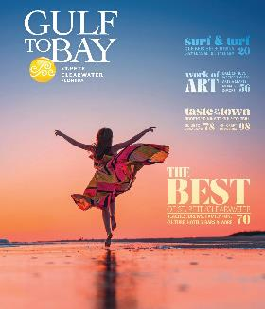
Print Media Gulf to Bay Destination Magazine
505,000
Distribution
Markets (395,000): 7/23 & 8/6
Chicago, Philadelphia, Wash DC, Boston, Atlanta, Cleveland, Pittsburgh, Indianapolis, Nashville, Columbus, Dayton, Cincinnati, Minneapolis, Detroit, New York City
Standalone Distribution (65,000):
Int'l & Domestic Events/Tradeshows, VISIT FLORIDA Welcome Centers, Tampa International Airport, St Pete/Clearwater International Airport, AAA Offices
Obtain Travel Information, Activities, Sightseeing from Guidebooks (187 Index)
Sunday Newspaper Insert Readership (128 Index)
Global Direct Mail (40,000):
Targeted Facebook Ads, Requests from Website Visitors, Annual Subscribers
Digital Downloads (5,000+)
Source: Fall 2021 Doublebase GfK MRI

Slide 28
Marketing partnerships & activations

Slide 29
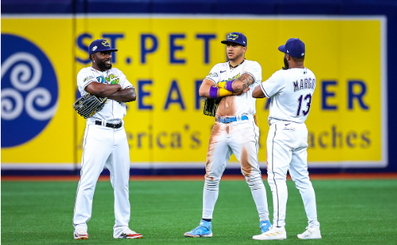
Marketing Partnerships & Activations Developmental + Maintenance Markets
Tampa Bay Rays
St. Pete, April – October
Philadelphia Union and Phillies
Philadelphia, May Onsite Activation
Piedmont Park Art Festival
Atlanta, Aug
Fall Fiesta in the Park
Orlando, Nov

Slide 30
Arts & culture co-op advertising

Slide 31
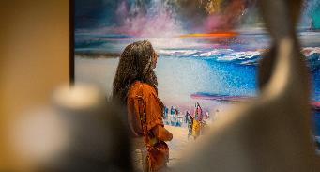
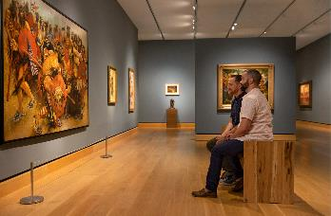
VSPC + Creative Pinellas Arts & Culture Co-op Program
Co-op program, open to all members of the arts community
Media selection targeted to reach in-market visitors and visitors who have booked a trip (e.g. billboards, print, digital)
All ads will include partner images/messages within the Visit St. Pete/Clearwater arts template
Total media cost will be split 50/50 between partner and VSPC/Creative Pinellas
Pilot program period: launch in May for media running July – September 2023

Slide 32
Creative extensions

Slide 33
From playlist to playtime

Slide 34
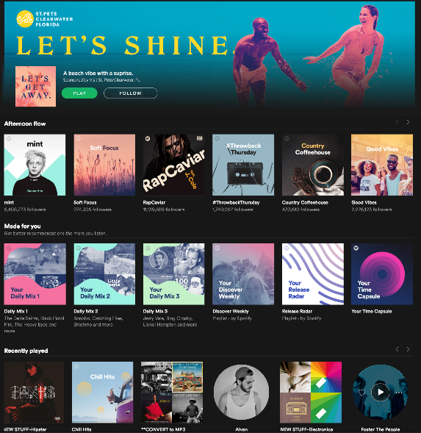
From Playlist
to Playtime
We know people listen to music to escape the everyday.
Let’s give them a beach-theme, auditory escape and for those drive-market listeners, give them the soundtrack to their next road trip to St. Pete/Clearwater with the Let’s Shine playlist.
Consumers can find the playlists via a Spotify Code (or other streaming platform) found in advertising across print, gas station TV, digital EV charging stations, gym TV, etc.

Slide 35
From Playlist to Playtime
Markets: Chicago, Atlanta, Indianapolis, Detroit, Minneapolis, Orlando, Jacksonville, Nashville and Cincinnati
Media Plan Integration
Atlanta and Florida Regional Print
Gas Station TV
Digital EV Charging Stations
Carvertise
Cross-device retargeting
Notes:
The chance to win will be limited, of course, adding urgency to grab trip to the beach.

Slide 36
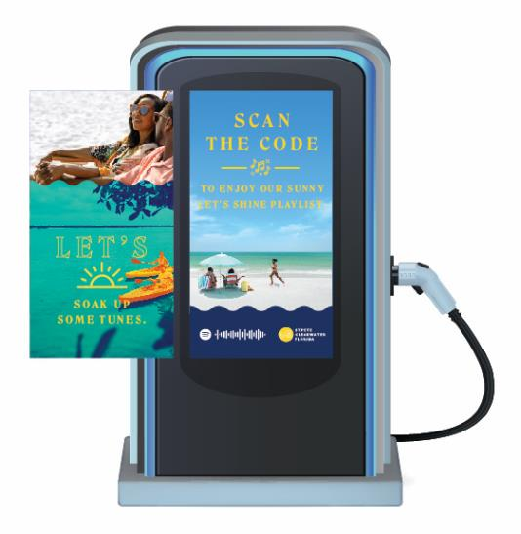
From Playlist to Playtime
Drive markets: :15 and :08 animations
Let’s hit the road.
Let’s get to the Gulf.
Let’s soak up some tunes.
Let’s Shine.
Scan the code to enjoy our sunny Let’s Shine playlist.
OOS markets: :15 animations
Let’s chill out.
Let’s enjoy some beach vibes.
Let’s soak up some tunes.
Let’s Shine.
Scan the code to enjoy our sunny Let’s Shine playlist.
Notes:
The playlists can be promoted in several environments — online ads, social media, through influencer partners, at event activations — and use a simple URL or QR code to direct people to listen on Spotify.

Slide 37
Live like a local influencers

Slide 38
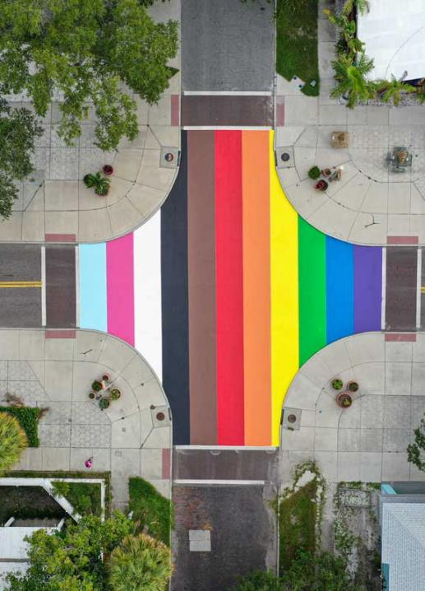
Like a Local Series
Continuing the success of our “Like a Local” program we will invite a series of social media influencers from key markets to come experience SPC like a local. Each vlogger would be paired up with one local expert.
Like a Local Gay Traveler in tandem with St. Pete Pride
Like a Local Beer Lover with Gulp Coast breweries
Like a Local Foodie with local chef/restauranteurs
Like a Local Accessibility Traveler
How It Works:
Partner with 4 influencers from May-August and host them each for 5 days.
Each creator will share their experience across YouTube, Instagram and TikTok. Content also to live on SPC channels.

Slide 39
Why It Works
Markets
Developmental Markets
Media Channels
Influencer marketing
Paid and organic social
Content development for earned channels (photos + blogs)
Projected Impressions
500,000
We’ll drive consideration beyond the beach and highlight local rich stories through emerging micro influencers.

Slide 40
Special award

Slide 41
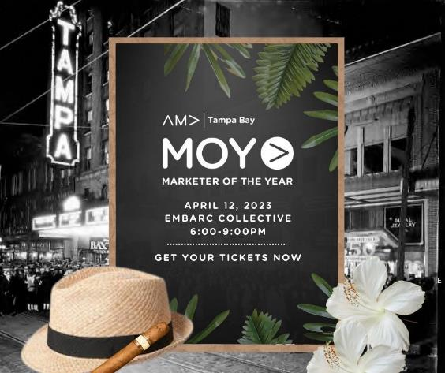
American Marketing Association (AMA) Tampa Bay
Last Wednesday, the American Marketing Association (AMA) Tampa Bay announced Visit St. Pete/ Clearwater as the eighth annual inductee into the AMA Tampa Bay Hall of Fame as part of the association’s signature event, Marketer of the Year Awards
Previous AMA Hall of Fame winners include Zoo Tampa Bay, the Tampa Bay Buccaneers, Tampa International Airport, Tampa General Hospital.
VSPC was recognized for its creative and strategic marketing strategies to successfully enhance the county’s economy through the support of a blooming tourism industry.

Slide 42
Thank you!

