Slide 1

SPORTS & Events
FY22 Recap
Prepared By: Craig Campbell, Director

Slide 2
RECAP
FY19 Benchmark
  Hosted Events: 95
  Room Nights Generated: 142,093
  Bed Tax Generated: $1M+
  Funding Provided: $760k
  Overnight Attendees: 130k
  Economic Impact: $77M
FY22 Performance
  Hosted Events: 119 (+24)
  Room Nights Generated: 162,361 (+20,268)
  Bed Tax Generated: $1.2M+ (+$150k)
  Funding Provided: $840k (+$80k)
  Overnight Attendees: 164k (+34k)
  Economic Impact: $109M (+$31M)
  Media Exposure: $640k

Slide 3
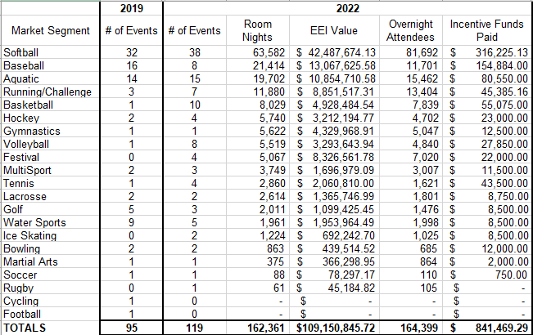
MARKET BREAKDOWN

Slide 4


ALL-STAR ROSTER
Caleb Peterson
Sr. Business Development Manager
Joined May 2018 / Promoted July 2022
Market Segments:
All Segments
International
Julie Bolfa
Business Development Manager
Joined March 2020
Market Segments:
Field Sports
Aquatics
Basketball
Tennis
Golf
Bowling
Volleyball
Gymnastics
Cycling

Slide 5
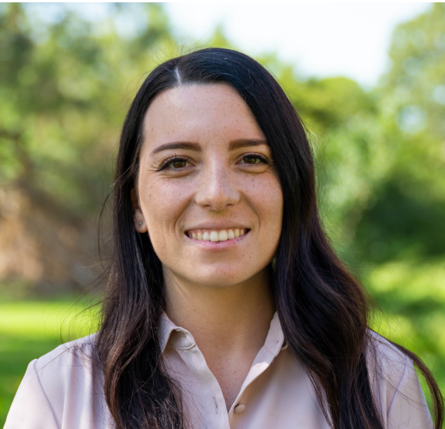

ALL-STAR ROSTER
Andrea Perla
Business Development Manager
Joined November 2022
Market Segments:
Mariah Kaylor
Business Manager
Joined January 2022
Focus:
A-to-Z Services
Softball
Baseball
Running
Ice Sports
Water Sports
LATAM
Adaptive

Slide 6
Thank you

