Slide 1
M E E T I N G S &
C O N F E R E N C E S
H O R T E N S I A S I M M O N S

Slide 2
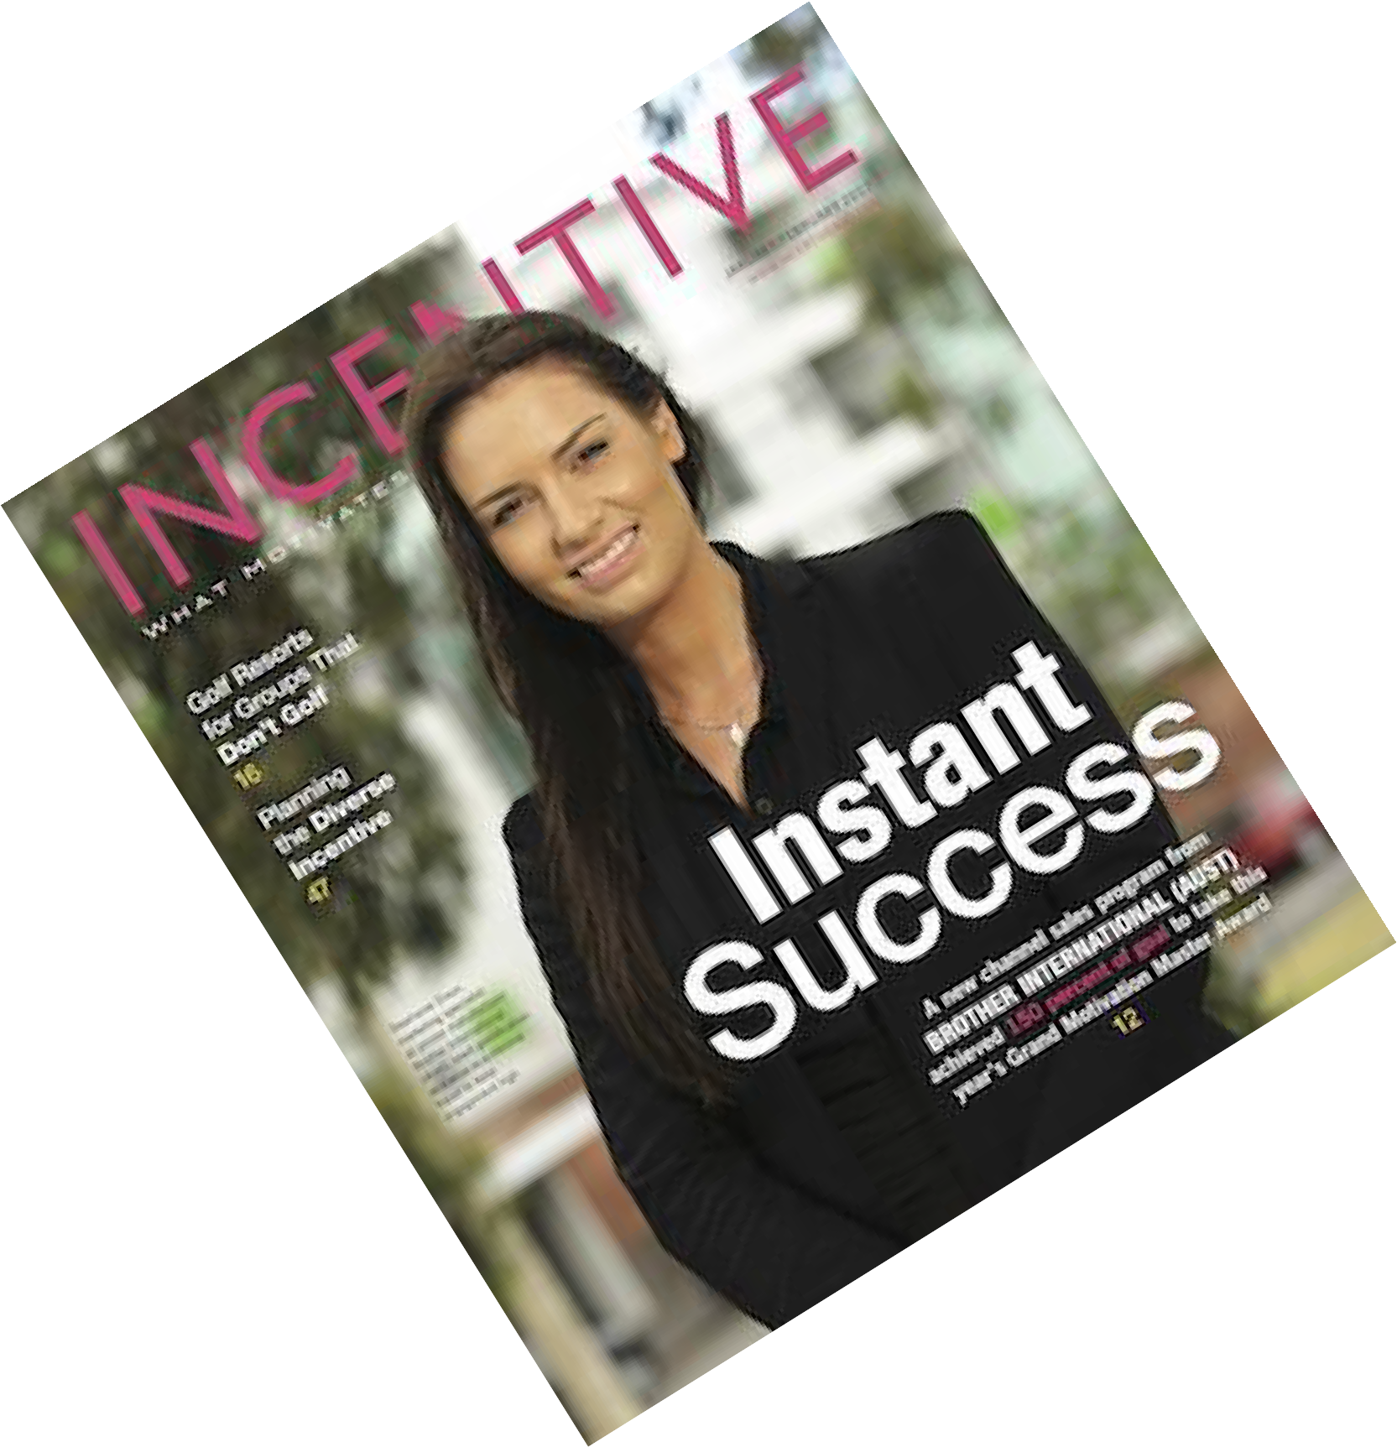
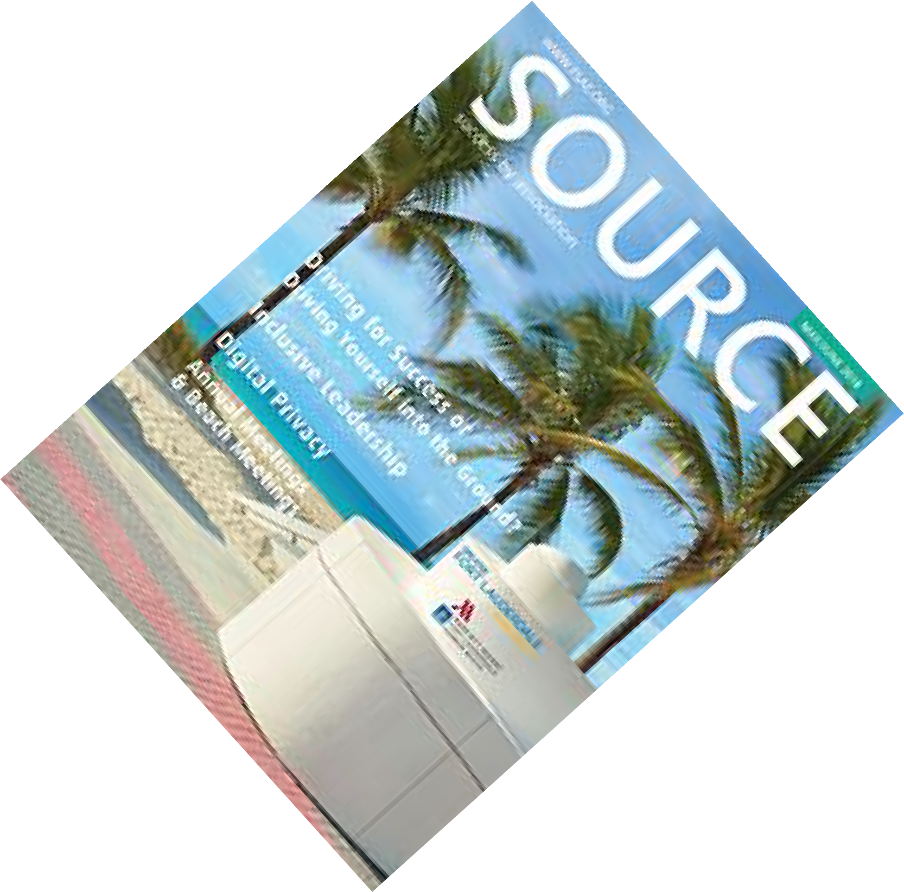
R e t u r n i n g P a r t n e r s
Co-op Opportunities!
Also includes:
- Advertorials
- Dedicated eblasts
- Inclusions in emails
- Website placements
- Retargeting banners
Continue with integrated programs
focusing on corporate/incentive and association planners.

Slide 3
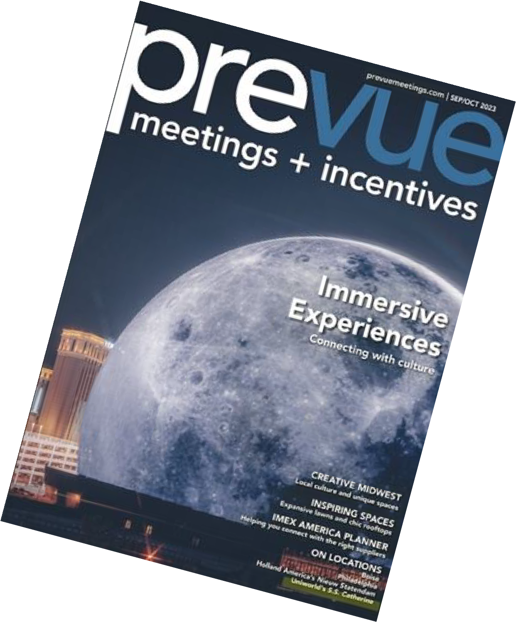
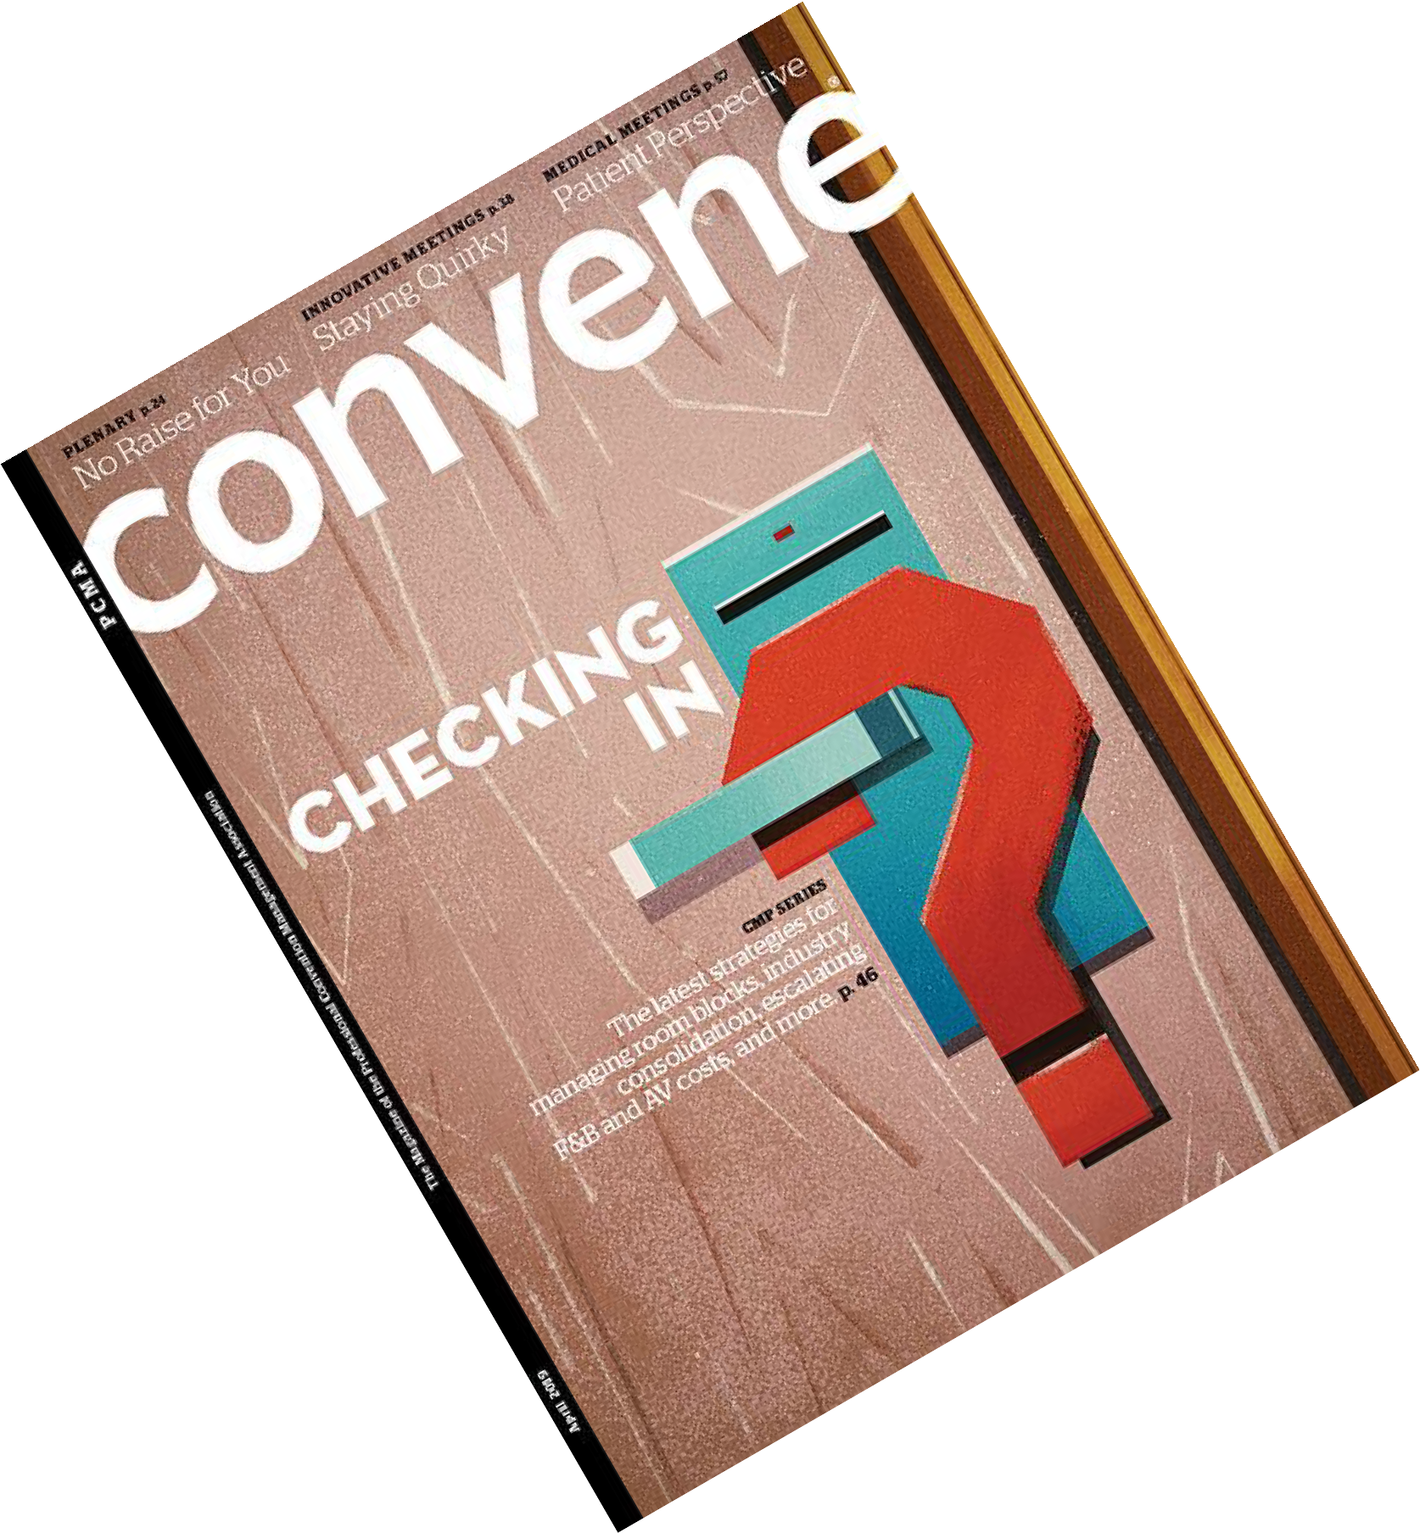
N e w P a r t n e r s
Co-op Opportunities!
Also includes:
Advertorials
Dedicated eblasts
Inclusions in emails
Website placements
Retargeting banners
Expanding corporate/incentive and association
placements while adding new SMERF placements.

Slide 4
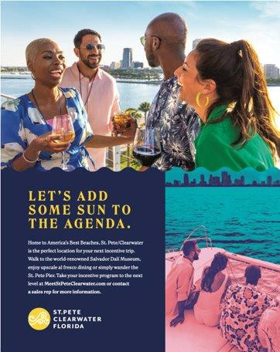

Slide 5
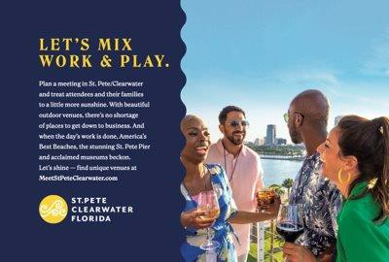

Slide 7
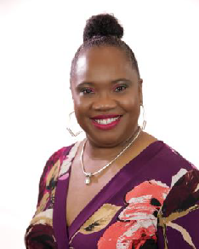
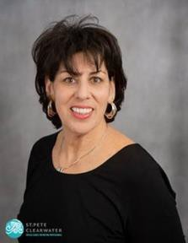
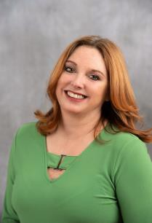
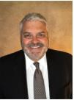
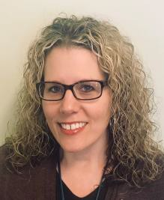
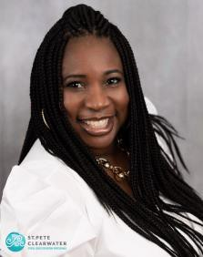
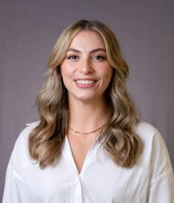
MEET THE TEAM
Hortensia Simmons Sr. Sales Manager –
Northeast/Canada, Religious & Fraternal
Liz Dane
DC Regional Sales Office -
Mid-Atlantic
Renee Prine Conventions
Services Manager, Weddings
Brian Hilterbrandt Sales Manager - West
Christine DeMato Meetings & Conventions Business Specialist
Tina Berrien
Sales Manager - Southeast
Kayla Freeman
Sales Manager - Florida

Slide 8
F Y 2 3 R e s u l t s
Leads Received 1,621
Definite Groups 292
Monetary Incentives $456,153
Total Room Nights 137,027
Total Economic Impact $126,588,567
Tourist Development Tax $2,994,562

Slide 9
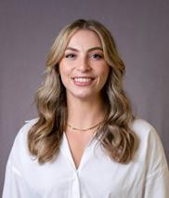
F L O R I D A B O O K I N G S
S H O W S A T T E N D E D : 8
R O O M N I G H T S : 2 4 , 1 5 1
E C O N O M I C I M P A C T : $ 1 5 , 4 9 1 , 4 4 9

Slide 10
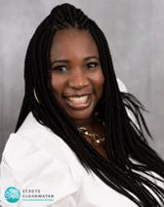
S O U T H E A S T B O O K I N G S
S H O W S A T T E N D E D : 8
R O O M N I G H T S : 2 8 , 6 5 2
E C O N O M I C I M P A C T : $ 2 2 , 6 3 1 , 6 4 4

Slide 11
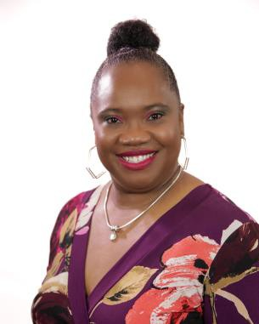
N O R T H E A S T B O O K I N G S
S H O W S A T T E N D E D : 1 5
R O O M N I G H T S : 1 6 , 2 8 1
E C O N O M I C I M P A C T : $ 1 0 , 4 3 7 , 3 0 1

Slide 12
M I D A T L A N T I C B O O K I N G S
S H O W S A T T E N D E D : 6
R O O M N I G H T S : 8 , 4 2 3
E C O N O M I C I M P A C T : $ 4 , 5 0 6 , 0 3 2

Slide 13
M I D W E S T B O O K I N G S
S H O W S A T T E N D E D : 5
R O O M N I G H T S : 2 2 , 5 4 5
E C O N O M I C I M P A C T : $ 1 3 , 9 7 1 , 3 3 7

Slide 14
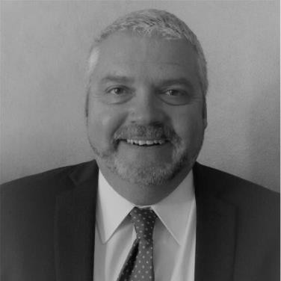
F A R W E S T B O O K I N G S
S H O W S A T T E N D E D : 1 0
R O O M N I G H T S : 1 2 , 1 1 3
E C O N O M I C I M P A C T : $ 8 , 0 8 5 , 7 5 1

Slide 15
N e w H o t e l s
J W M a r r i o t t
C l e a r w a t e r B e a c h : 1 9 8
t o t a l 1 7 , 0 0 0
r o o m s & o v e r
S q . F t M e e t i n g
S p a c e
A C H o t e l C l e a r w a t e r
B e a c h -
1 4 4 t o t a l r o o m s
A C H o t e l D o w n t o w n
S t . P e t e - 1 7 2 r o o m s &
1 8 0 0 S q . F t o f M e e t i n g S p a c e
T h e M i n t H o u s e
D o w n t o w n S t . P e t e - 8 5 A p a r t m e n t s t y l e u n i t s

Slide 16
Awards
2023 ConventionSouth Readers' Choice Award
2023 Smart Stars in the Best CVB/DMO Category
2023 Smart Meetings Platinum Choice Award

Slide 17
N E W T R A D E S H O W S !
LUXURY MEETINGS
DESTINATIONS LINK NE
FACE TO FACE CLIENT EVENTS
GBTA CONVENTION
IBTM WORLD

Slide 18
I n c e n t i v e P r o g r a m G u i d e l i n e s
$3 - $5 per room night
Amounts determined on a case-by-case scenario.
Hotels should use all efforts to win business independently.
The group must contract a minimum of 100 cumulative room nights to be eligible for incentive.
Monetary incentives to master accounts cannot be used in conjunction with other incentives such as group transportation.
Incentive request should come from hotel or third party only- client may not request/receive incentive.

Slide 19
Site Selection
Digital Media Gallery Access
Save the Date Postcard Mailers
Local Vendor Recommendations; DMC, Transportation, Off-Site Venues, and more!
Welcome Marquee at TPA
Bags & Brochures
Social Media Shoutouts
C o n v e n t i o n S e r v i c e s
Complimentary convention services.

Slide 20
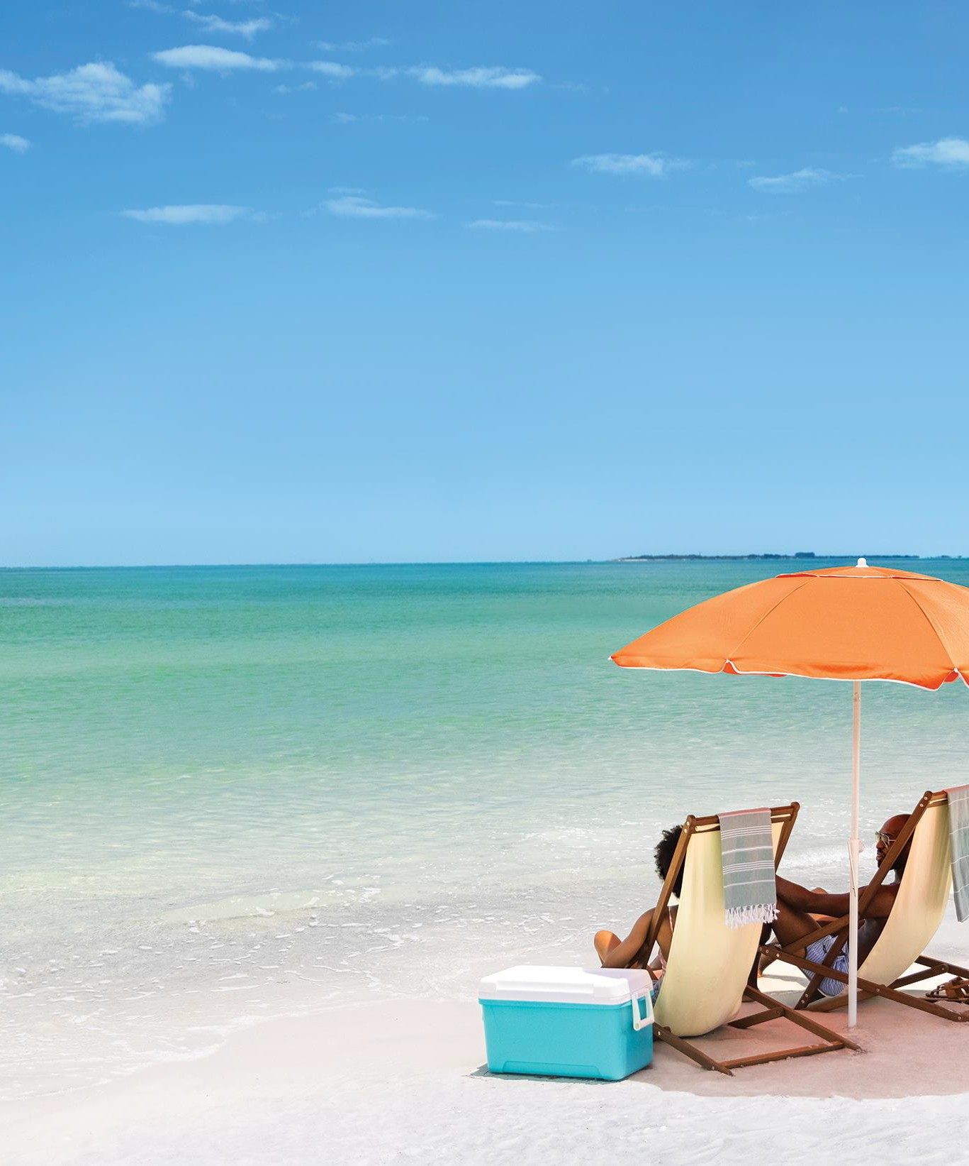
C O M I N G U P !
Holiday Showcase 11/28-30
NCBMP 12/5-9
Smart Meetings Luxe 12/10-13
PCMA Client Spa Event,
San Diego– 1/7-10/24
Religious Conference
Management Assoc.– 1/8-12/24

